Slide 1

Advanced D3D10 Shader Authoring
Presentation/Presenter Title Slide

Slide 2

Overview
Review of Direct3D 10 and HLSL 4.0
The power of the programmable pipeline
Guided exercises: Visualizer

Slide 3
Some New D3D10 Features
Completely re-architected from D3D9 for configurability and performance
Geometry Shader
Fixed-function lighting and transformation now programmable in HLSL 4.0
Configurable pipeline
  Flexible shader signatures
  System-generated values

Slide 4
High Level Shader Language
HLSL is a highly effective language for writing shaders
Syntax is similar to ‘C’
  Preprocessor defines (#define, #ifdef, etc)
  Basic types (float, int, uint, bool, etc)
  Operators, variables, functions
Has some important differences
  Builtin variables (float4, matrix, etc)
  Intrinsic functions (mul, normalize, etc)

Slide 5
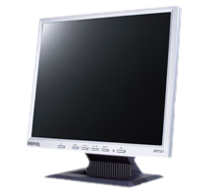
Overview of the Pipeline
Effect
Shader Constants
Vertex
Shader
Geometry
Shader
Pixel
Shader
Triangles
Textures / Buffers

Slide 6
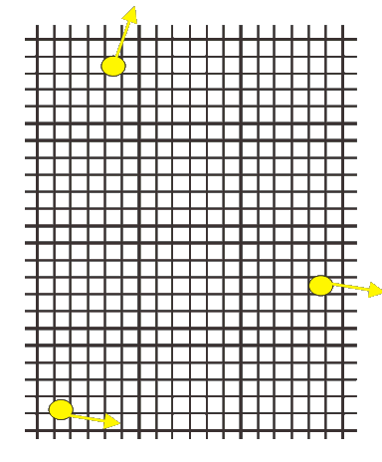
Vertex Shader 4.0
Input
  Vertices
  Shader Constants
  System Variables ( VertexID )
Output
  It’s up to you now
  Color, Texture Coordinates, etc

Slide 7
System-generated Values
Values usable in shaders generated by the D3D10 runtime
Act exactly like semantics, just tag your variable and off you go
SV_VertexID
  Provided to the VS
SV_InstanceID
  Provided to the VS
SV_PrimitiveID
  Provided to the GS (or PS if there is no GS)

Slide 8
Geometry Shader 4.0
Input
  Per-primitive data (3 verts for a tri)
  System variables ( PrimitiveID )
Output
  Points, lines, triangles
  Render target index, clip distances
  Stream data to a buffer on the GPU
    aka stream out

Slide 9
Geometry Shader Restrictions
Cannot output more than 4096 bytes of information for each input primitive
  Performance is not guaranteed when amplifying at this level

Slide 10
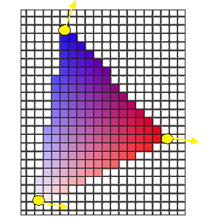
Pixel Shader 4.0
Input
  Interpolated data from vertex shader
Output
  Pixel color (with alpha)
  Optional: depth

Slide 11
What This Means: Configurability
The real power of Direct3D 10 is that there are many ways to accomplish any one task
More and more tasks can be pushed onto the GPU
Performance/quality tradeoff can be made on your terms

Slide 12
Guided Exercises: Visualizer
DirectX 10 - exploitive effects in an audio visualizer
Roughly based on the GPUSpectrogram sample in available in the DirectX SDK
A framework to try out HLSL 4.0 plus to show:
  InstanceIDs
  Integer offset samplers
  Geometry amplification
Debugging using PIX

Slide 13

Guided Exercises
General Directions
Each effect file guides you through the exercises.
Breakdancin’ Bob shows up in the comments where there is something to learn or something to do.
Use Visual Studio to edit the effect and cpp files and to build.
If you get stuck or need help, raise your hand. A proctor will assist you.

Slide 14
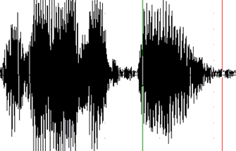








The Basic Idea
GPUSpectrogram uses the GPU to analyze the raw audio data and evaluate the levels of various frequency ranges
  To check this code out and see the new integer instruction set in action, check out the GPUSpectrogram sample or GPUSpectrogram.fx included in the workshop

Slide 15
Using Spectrogram Data
We’ll be using shaders to take this data and make a visualizer
  Dancing bars with extra effects
These techniques directly apply to game scenarios
  The configurability of the pipeline makes the possibilities endless

Slide 16
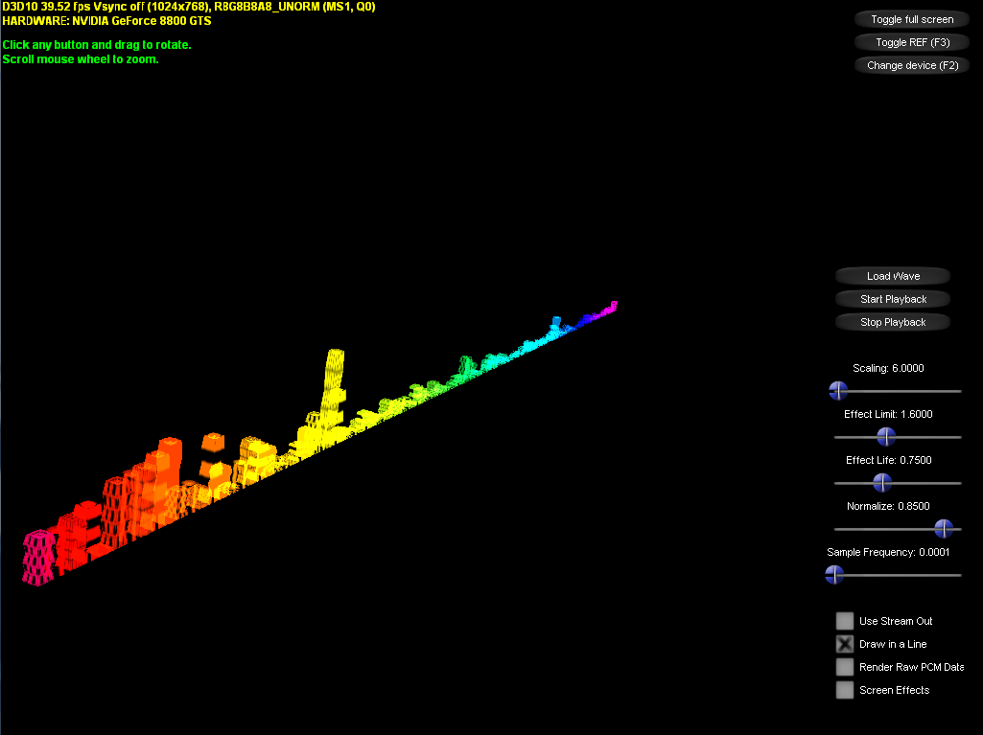
Exercise 1: Drawing the Bars
Please open Exercise01.sln
Hint: Bob’s hiding in Exercise01.fx

Slide 17
Exercise 1: Drawing the Bars
Solution:
input.Pos.y *= abs(spectrogram.r)*fScale*g_fScale;

Slide 18
Exercise 2: Performance
We’ll be using PIX to do performance analysis
Build Exercise02.sln
Open PIX (Start->PIX for Windows)
File -> New Experiment
Navigate to your built exercise
Select “A replayable Direct3D call stream, saved to file:”
Enter a file name ending in “.PIXrun”
Click “Start Experiment”

Slide 19
Exercise 2: Performance
When you exit the application, you’ll have a log of every D3D command that was executed
We’ve created a perf event called “Draw Bars” that will help you find the actual draw calls for the bars.
There is a small problem in how it’s rendering that’s causing a loss in performance…
You might want to look in Exercise02.cpp

Slide 20
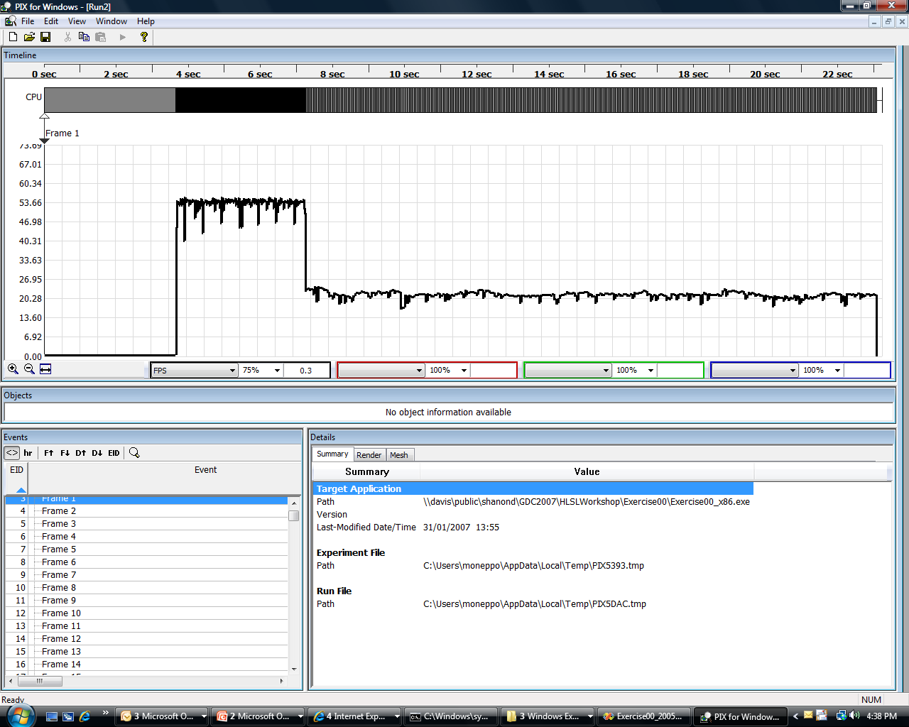
Exercise 2: Debugging

Slide 21
Exercise 2: Performance
Solution:
pd3dDevice->DrawIndexedInstanced(
(UINT)pSubset->IndexCount, g_iNumInstances, 0, (UINT)pSubset->VertexStart, 0 );

Slide 22
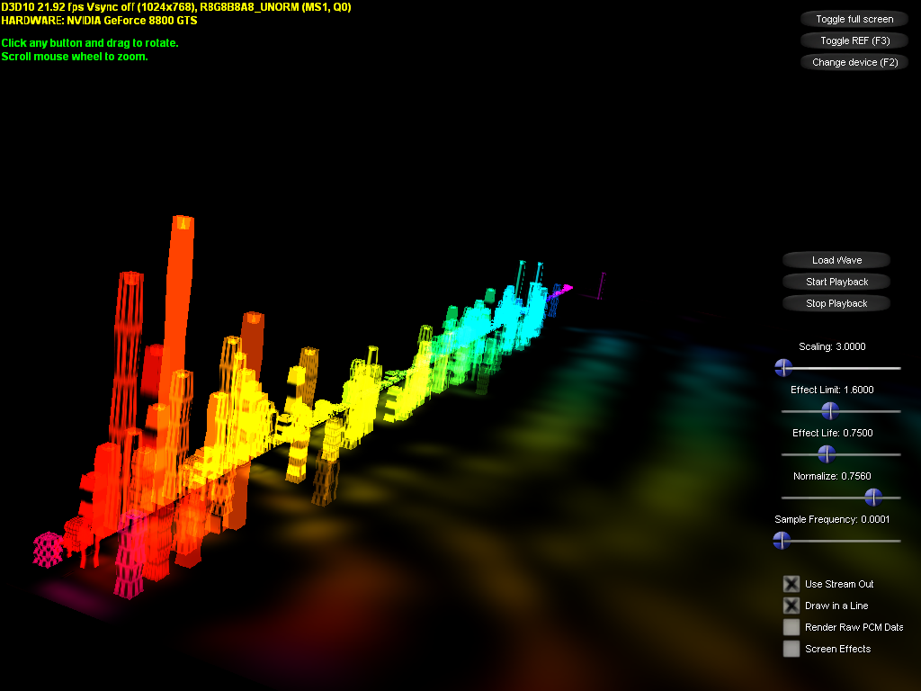
Exercise 3: Geometry Amplification
Please open Exercise3.sln
Hint: Bob’s hiding in Exercise3.fx

Slide 23
Exercise 3: Geometry Amplification
Solution:
  TriStream.Append( output );

Slide 24
Exercise 4: More Performance
We’ll be using PIX to see how we can tweak rendering parameters to maximize performance
We’ve made a custom set of variables you can track in PIX so you can see the values of the sliders
We’ll be seeing how changing these values changes framerate

Slide 25
Exercise 4: More Performance
Build Exercise04.sln
Open PIX (Start->PIX for Windows)
File -> New Experiment
Navigate to your built exercise
Click “More Options”
For CounterSet, select “(Custom)”
Add all counters under the “Pluging Counters”
Click “OK”
Click “Start Experiment”

Slide 26
Exercise 4: More Debugging

Slide 27
Exercise 4: More Debugging
You can assign colored lines to each of the slider values along the bottom of the chat
You can also set the framerate as a graphed line
You can see the framerate has a direct correlation to many of these sliders (some more than others)

Slide 28
Exercise 5: Floor Effect
Please open Exercise05.sln
Hint: Bob’s hiding in Exercise05.fx

Slide 29
Exercise 5: Floor Effect
Solution:
tex.x += sin( input.Tex.y*40 )*0.001;
tex.y += sin( input.Tex.y*60 )*0.001;

Slide 30
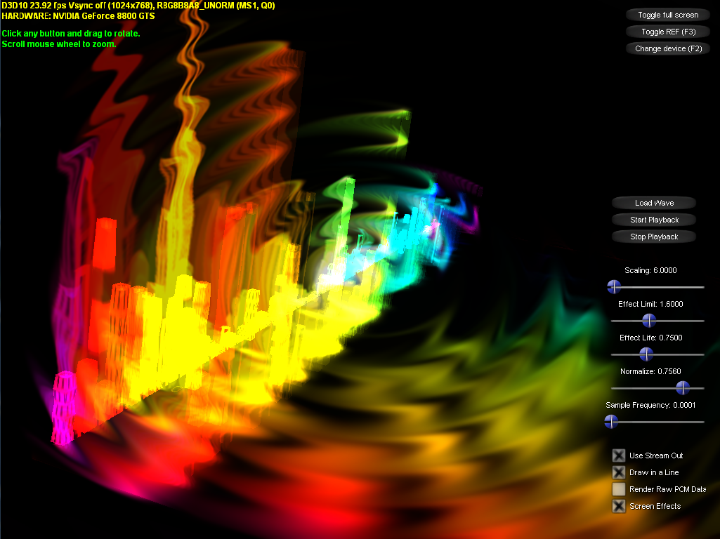
Exercise 6: Screen Effects
Please open Exercise06.sln
Hint: Bob’s hiding in Exercise06.fx

Slide 31
Exercise 6: Screen Effects
Solution (One of many!):
float2 tex = input.Tex.xy*2 - 1;
float texMag = length( tex );
tex /= texMag;
float shift = sin(texMag*50.0-g_fTime*3)*g_fElapsedTime*0.3;
float2 offset = float2(tex.y*shift, -tex.x*shift );
tex *= texMag;
tex += offset;
tex = tex/2 + 0.5;
float4 color = BoxFilter( g_samLinearClamp, tex, 3 );
return color * 0.80;

Slide 32


End Slide
www.xna.com
© 2007 Microsoft Corporation. All rights reserved.
This presentation is for informational purposes only. Microsoft makes no warranties, express or implied, in this summary.

